Slide 1
Chapter 7
Communication and Family Roles and Types

Slide 2
What is a family role?
Recurring patterns of behavior developed through family members’ interactions enacted in order to fulfill family functions
Words such as mother, father, breadwinner, stay-at-home parent, mother-in-law
Definitions vary from group to group as these roles are complex
Roles are established within families, grown into over time, grown out of, discussed, negotiated, redefined, and accepted or rejected

Slide 3

Family Roles
Emerge through dialogue with other family members
Currently less tied to age because of increased longevity and more fluid life stages

Slide 4
Interactive Role Development
The identity background and role models of a person who occupies a social position, such as an oldest son
The relationships in which a person interacts
The changes each family member experiences as he or she moves through the life cycle or encounters life crises
The effects of each member’s role performance on the family system
The extent to which a person’s social/psychological identity is defined and enhanced by a particular role

Slide 5
McMaster Model of Family Functioning
Focuses on discovering how a family allocates and manages family responsibilities.
Uses a systems perspective.
Providing adult sexual fulfillment and children’s gender socialization
Providing nurturing and emotional support
Providing for individual development
Providing for kinship maintenance and family management
Providing basic resources

Slide 6
MMFF
Function | Roles
Instrumental | Resource provision
Affective | Support and nurturing; adult sexual needs and children’s gender development
Mixed | Life-skill development and system upkeep

Slide 7
Providing for Gender Socialization
Family members teach children, implicitly and explicitly, what is “masculine” and what is “feminine”
Alternately, they teach children what is means to be male and what is means to be female
This is done through feedback, rewards and critique, and other commentary about food, appearance, toys, and behavior
Gender differences in communication styles impact families, though they are shifted as adult spouses roles as parents are merging rather than the distinct division of gendered labor that characterized earlier periods of family life
In same-sex couples, we see more negotiation because gender role models may not exist and gendered expectations may be more fluid

Slide 8
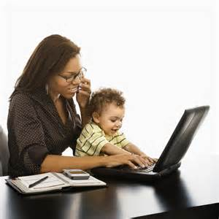
Androgynous Role Enactment
Androgynous individuals possess qualities that culture defines as masculine and feminine instead of only assigned to one sex
Role choices are based on merits or qualifications rather than sex or gender
Androgynous people are flexible, adaptive, and capable of being both instrumental and expressive

Slide 9
Providing Nurturing, Support, and Empathy
From a transactional perspective, family satisfaction increases when each member meets the needs and expectations of the others.
Nurturing children:
Until recently mothers served as the primary caregiver because they had far greater contact with their children than did fathers
Today’s fathers spend more time with their children than in the past
Nurturing occurs through communication including advice, directives, and answers to questions
Learning occurs through observing others
Older siblings influence the process of learning due to the time spent together and the role model they become for younger siblings

Slide 10

Providing Support & Empathy
This function implies a willingness to focus on another’s needs, listen to another’s problems, and provide emotional support.
Empathy implies conveying nonjudgemental understanding and concerns for another.

Slide 11
Providing for Individual Development
This role function includes those tasks that each individual must fulfill in order to become self-sufficient.
Young family members who cannot accomplish a task can easily become dependent on a family system.
Recognition of members’ ideas, arguments, and decisions creates a context for valuing independence.
How might a rigid family differ from a flexible family in terms of independence?

Slide 12
Providing for Kinship Maintenance and Family Management
These functions address issues of maintaining relational ties and m
anaging the daily lives and needs of all members.
Kinship maintenance involves the communications and connection with an extended family group
These interactions primarily include: visiting, recreation, and communication
Can be called kinkeepers and most likely to be female family members
Kin-work is the labor that allows family to endure over time

Slide 13
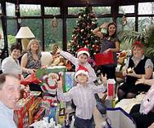
Influences on Extended Kinship
Marriage status – blended and divorced families experience different issues related to kinship management
Culture impacts gendered experience – some cultures have both men and women kinkeepers in equal levels

Slide 14
Management of Daily Needs
Decision making surrounding housekeepings, child care, recreation, and managing of family finances
Division of labor is impacted by income levels and work status
Often a source of conflict
Recreation management is coordinating leisure activities for the family
Cohesive families encourage much group recreational activity while low-cohesion families do not
Can also be health management

Slide 15
Providing Basic Resources
Traditionally men serves as the major financial provider in families, though there have always been exceptions
This is no longer a gendered expectation expected only of men
Women are now often the primary breadwinner in homes, especially since there are many single mothers who do all the household management
Because of the dual-earner, or reduced expectation that only can can/should be the breadwinner, our new lifestyes are most stressful as families negotiate roles and manage work/life commitments

Slide 16
Spillover
Merging the roles of provider/worker and family member creates spillover.
This is bidirectional – family can impact work and work can impact family demands.
Even more challenging for low-income, unmarried mothers.
Role negotiation – ongoing role coordination – helps parents manage spillover

Slide 17
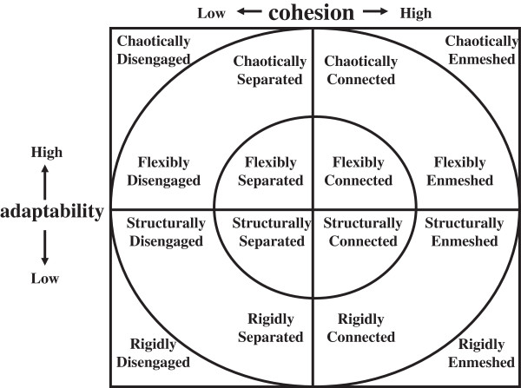
Reflecting on the Circumplex Model

Slide 18
The Role Appropriation Process
Role expectations
Role enactment
Role negotiation

Slide 19
Role Expectations
Society provides role models and norms for how certain family roles should be enacted – this creates role expectations
Role models can be found in the media, in person, through religious organizations and principles, and in the community
These expectations develop over time as one grows up

Slide 20

Role Expectations
Significant others: people you view as important and who provide you with models from which you develop role expectations
Learning through observation and imitating others
Complementary others: people who fulfill reciprocal role functions (husband – wife; parent – child)

Slide 21
Role Expectations
Represent an imagined view of yourself
Only a true role when you are actually enacting the role (ex: mother)

Slide 22
Role Enactment
The performance of a role
Impacted by complementary roles
When complementary roles view their roles similarly, it enhances the role performance
Influenced by one’s background/history/culture
Requires self-confidence/self-efficacy

Slide 23

Role Enactment
Choosing one role may affect one’s ability to assume other roles

Slide 24
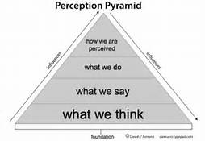
Role Enactment
Role enactment is perceived differently by each person, especially in families

Slide 25
Role Negotiation
The process of interaction that gives meaning to people’s lives and socially constructs one’s reality; includes the management of conflict related to role enactment
Communication is used to take on and maintain all family roles
Can be implicit or explicit
Will need to be integrated with other members’ roles

Slide 26
Role Negotiation
If complementary or significant others have different expectations for their own or your role performance, conflict will ensue.
Conflict also occurs when one person in a family tries to take on incompatible roles

Slide 27

Work-Life Balance Issues
Arlie Hochschild termed the phrase, “The second shift”
“Men who shared the load at home seemed just as pressed for time as their wives, and torn between the demands of career and small children...But the majority of men did not share the load at home. Some refused outright. Others refused more passively, often offering a loving shoulder to lean on, an understanding ear as their working wife faced the conflict they both saw as hers.” – Hochschild, The Second Shift

Slide 28
Work-Family Border Theory
Sue Campbell Clark (2000)
Explains why conflict between work and home increases and decreases; focused on role conflict
When work and home have similar cultures and weak borders, it is easier to flow back and forth (border crossing) between them, causing less conflict.
In cases where one domain has a strong border and the other has a weak borer, work-family balance favors the domain with which a person identifies most strongly.

Slide 29
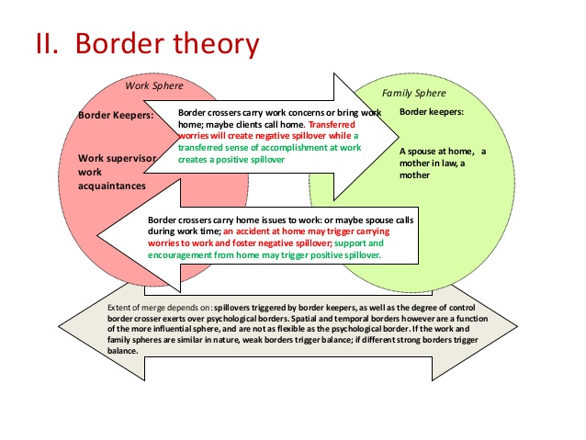

Slide 30
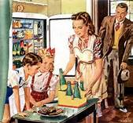
Role Conflict
Heightened when we are enacting roles in ways that are outdated for couples and families.

Slide 31
Couple and Family Typologies
Traditionals
Separates
Independents

Slide 32
Facts that affect role enactment
Conflict avoidance
Assertiveness
Sharing
The ideology of traditionalism
The ideology of uncertainty and change
Time regularity
Undifferentiated space
Autonomy

Slide 33
Independents
Accept uncertainty and change
Pay limited attention to schedules and traditional values
More likely to have conflict
More likely to support androgynous, flexible sex roles

Slide 34
Separates
Greater conflict avoidance than independents
More differentiated space needs
Fairly regular schedules
Less sharing
Gendered roles

Slide 35
Traditionals
Fairly conventional belief system
Resist change due to uncertainty because it threatens routines
High interdependence and low autonomy
Will engage in conflict but try to avoid it
Sex-typed role division

Slide 36
Gender-Organized Couple Types
Post-gender: Those making a conscious decision to move past gender as a way to organize the relationship and tasks associated with it.
Gender-legacy: Overtly recognize gender as the reason for their division of labor, but use it by default to do so
Traditional couples: Use gender as a conscious method of dividing labor in the relationship and see their roles as different but equal.

Slide 37
Family Typologies
Families can function well with a variety of communication styes
Conformity orientation
High conformity: members express similar values and attitudes which enhances harmony
Low conformity: More varied values, attitudes, and patterns of interaction; upholds individuality and brings out unique personalities of members
Conversation orientation
High conversation: open family system and individuals can speak minds easily with little fear
Low conversation: Members speak out less frequently on fewer conflict issues

Slide 38
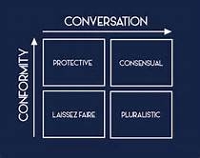
Family Typologies

